Slide 1
___ & IBM Workshop IBM’s Platform for ‘ML at Scale’ (A.I. for structured data)

Slide 2
Agenda
Context
Drivers, approach, assessment parameters for ‘ML at Scale’ platform
Autonomic assets: A new lens to view the objectives of ‘ML at Scale’
Conceptual architecture with accelerators and enablers
Architecture
Smarter Resource & Operations Management (SROM)
IBM Predictive Insights & PMQ
Break
Use case discussion
Next steps discussion
IBM Confidential | Page 2

Slide 3
Agenda
Context
Drivers, approach, assessment parameters for ‘ML at Scale’ platform
Autonomic assets: A new lens to view the objectives of ‘ML at Scale’
Conceptual architecture with accelerators and enablers
Architecture
Smarter Resource & Operations Management (SROM)
IBM Predictive Insights & PMQ
Break
Use case discussion
Next steps discussion
IBM Confidential | Page 3

Slide 4


Client’s Strategic Intent for ____ & beyond: IBM’s understanding
The What
The Building Automation lifecycle
The How
Leverage
1
Design
2
Configure
Augment
Current capability
E.g. Configuration of control system / sequence to meet requirements
E.g. Assisted Building Design
Uplift the complete lifecycle to transform
customer experience, energy efficiency, technical support & maintenance,
MTTR, Truck Rolls
…...
with
?
4
Operate
3
Commission
Room too hot/cold scenario – manage the complete experience
Energy optimization for HVAC systems - ML at scale problem
Predictive maintenance and predictive scheduling
E.g. Are the systems wired properly and balanced?
IBM Confidential | Page 4

Slide 5
’Machine Learning at Scale’: Three main scenarios within the ‘Operations’ phase that must be supported for ___.
1. “Energy optimization at scale” as a business
2. “Predictive maintenance at scale” as a business
3. “Personalized user experiences through granular control at scale” as a business
IBM Confidential | Page 5

Slide 6
What could ___ leverage with these new capabilities?
Higher product push-through product revenues
New / deeper monetization capabilities for Metasys
Vertically integrated business models like intelligent energy sourcing: Leverage ST, LT weather forecasts to predict energy loads, forecast commodity prices, optimize energy consumption, and optimize energy mix so as to enable business models like guaranteed Cost/Kwh or a guaranteed energy cost / month for building operators, Remote Operations Centers (ROCs)
Capitalize on opportunities created by the need to manage climate change. E.g. COP 21 tracking & target attainment
IBM Confidential | Page 6

Slide 7
Agenda
Context
Drivers, approach, assessment parameters for ‘ML at Scale’ platform
Autonomic assets: A new lens to view the objectives of ‘ML at Scale’
Conceptual architecture with accelerators and enablers
Architecture
Smarter Resource & Operations Management (SROM)
IBM Predictive Insights & PMQ
Break
Use case discussion
Next steps discussion
IBM Confidential | Page 7

Slide 8
Agenda
Context
Drivers, approach, assessment parameters for ‘ML at Scale’ platform
Autonomic assets: A new lens to view the objectives of ‘ML at Scale’
Conceptual architecture with accelerators and enablers
Architecture
Smarter Resource & Operations Management (SROM)
IBM Predictive Insights & PMQ
Break
Use case discussion
Next steps discussion
IBM Confidential | Page 8

Slide 9
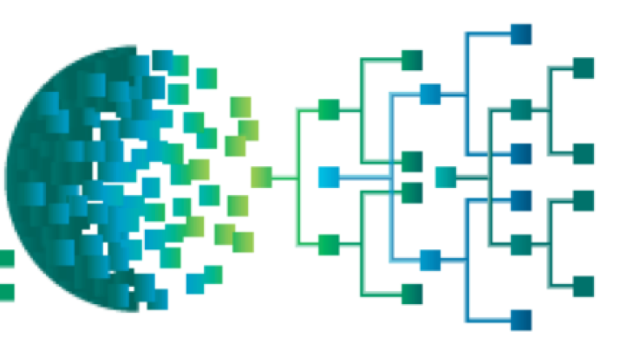

Today, Operations need to solve high-impact problems for customers with high expectations in increasingly complex environments
Increasingly complex technology-intensive operations environments
A leading freight company lost $120 million in revenue because IT was unaware that critical warning messages were associated with their key freight delivery application
58% of survey participants said their enterprise had between 6 and 40 different monitoring tools
Mean Time to Repair for application-related problems is often 3-6 hours
Airline canceled more than 700 flights and another 765 flights are delayed due to a software outage – Blamed ticketing partner while the real problem was on their end
Today’s customers are increasingly vocal, and often vent on social media, like when a video streaming company had a software outage for more than 20 hours
Trading halted for half a day on the biggest US exchange for financial options following an outage caused by software problems
IBM Confidential | Page 9

Slide 10
IBM overcomes limitations of traditional methods and brings Operations closer to Autonomic Assets
The Journey to Autonomic Asset
Better automation
Better Detection and Prediction
Better Diagnoses
Better Remediation &
Self-healing
Issue
Issues occur with no or limited prior warnings; can cost millions of dollars
Misconfigurations happen, systems misbehave. Rule-based systems cannot capture complex interactions
Detection often disruptive, possibly destructive
Diagnosis often disruptive, possibly destructive
Inability to identify causes and linkages delays remediation
Largely manual processes with high-risk, and higher MTTR
Point solutions / limited to automated scripts that are manually invoked after establishing root cause
Traditional Approach
Detection happens through monitoring tools, automated alerts, or reported by users
Reliance on descriptive capabilities
Manual analysis of logs
Experiential
Rule-based, brittle
Trial and error-based
Dependence on specific SMEs
Add redundancy
Limited visibility
None, or limited to frequently occurring issues with simple actions
IBM’s
Approach
IBM ‘ML at Scale’
IBM Predictive Insights
PMQ
IBM Watson
IBM ‘ML at Scale’
IBM Predictive Insights
IBM Metadata crawling
PMQ
IBM Watson + IBM Predictive Insights + IBM ‘ML at Scale’ + IBM Metadata crawling + PMQ + Automation
IBM Confidential | Page 10

Slide 11

For the critically important decision on the right ‘ML at Scale’ platform, companies are typically choosing from approaches
Build own platform to cater to installed base
WHITE LABEL a 3rd PARTY platform
HYBRID PLATFORM STRATEGY
IBM Confidential | Page 11

Slide 12

IBM offers accelerators for ‘ML at Scale’ across the complete ML Value Chain and support both white labeling & hybrid strategies - all in an XaaS model
Channels
Service Catalog
SaaS • DaaS • XaaS
Access
Data Science Zone
ML Model Management
PMQ
SROM
Operations
Analytics
ML Tools: DSX, SPSS, SystemML
Data Management Zone
Data Access
Weather Company Data
Insights for Twitter
Namara.io Catalog
Building Data
Ingestion and blending
PMQ, MDM (Energy and Utility)
Asset hierarchy
Platform
Cloud • Security • Big Data • Streaming • Watson IoT • Tools • DevOps
IBM Confidential | Page 12
Notes:
Operations analytics – PI, Log & Netcool operational insights

Slide 13
Agenda
Context
Drivers, approach, assessment parameters for ‘ML at Scale’ platform
Autonomic assets: A new lens to view the objectives of ‘ML at Scale’
Conceptual architecture with accelerators and enablers
Architecture
Smarter Resource & Operations Management (SROM)
IBM Predictive Insights & PMQ
Break
Use case discussion
Next steps discussion
IBM Confidential | Page 13

Slide 14
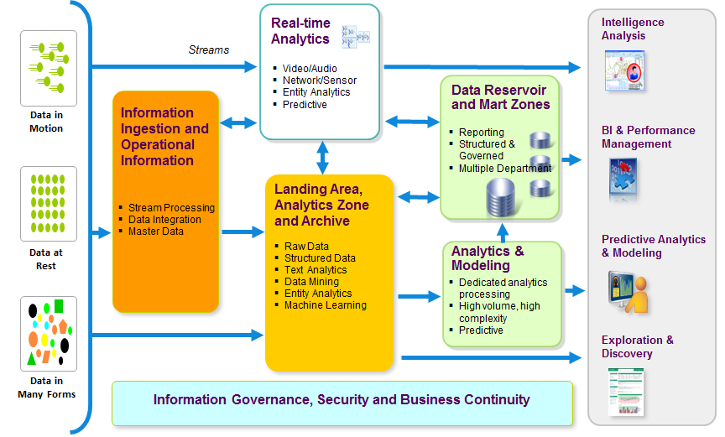
A holistic architecture joins multiple data sources in order to provide users a single, seamless view of information.
IBM Confidential | Page 14
Notes:
14

Slide 15

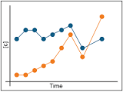



Realizing fault prediction and performance degradation with Machine Learning at scale
Data Center in the Cloud
Data sources
Outputs and Data Visualization
API Publication
Analytical Reports
Data Landing Zone
Warehouse
Analytics & Exploration
Solutions
Sensor data
SROM
Data Ingestion Batch
Raw data
Equipment data
Anomaly Detection
Time-series
ML Algorithms
Data Lake
Extract
Transform
Load
Connectivity and Security Gateway
….
Feature matrix
Failure Risk Analysis
Transformed
Metadata
Quality
Connectivity and Security Gateway
Shared Operational Information
Security & Governance
IBM Confidential | Page 15

Slide 16

IBM reference architecture provides a holistic framework for consideration
Data Center in the Cloud
Data sources
Outputs and Data Visualization
Machine &
Sensor Data
API Publication
Notification Services
User Experience
Analytical Reports
...
Services
Portal
Data Landing Zone
Warehouse
Analytics & Exploration
Solutions
Filtered
Data
Real-time
Data
Analytics
Strream Processing
Off-line Data
Exploration
And
Navigation
Predictive
Maintenance
Analyzed
Data
Data Stores
Asset
Optimization
Connectivity and Security Gateway
(Big) Data
Repository
Off-line Data
Analytics
Descriptive
Predictive
Prescriptive
Cognitive
Summarized
Data
Quality
Monitoring
Historian
Database
Raw
Data
Incident
Analysis
Connectivity and Security Gateway
Systems
(Enterprise, Call Center, ..)
Shared Operational Information
360º View
(Client, Asset, Failure, etc)
Master Data
Management
Asset Data
Management
Document
Repositories
3rd Party
Data Sources
(e.g. Weather)
Cognitive
Analytics
3rd
Party
Device Management
Security & Governance
IBM Confidential | Page 16

Slide 17




























IBM Bluemix is an open-standards, cloud-based platform for building, running, and managing applications
DevOps
Tooling
Your Own Hosted Apps / Services
Integration and API Mgmt
Choice with Consistency
Catalog of Services that Extend Apps’ Functionality
DevOps Productivity
+
Web
Data
Mobile
Cognitive
Analytics
IoT
Security
Yours
Industrialized Hybrid Cloud
Flexible Compute Options to Run Apps / Services
Instant Runtimes
+
Containers
+
Virtual Machines
+
Powerful, Accessible
Analytics with Cognitive
Platform Deployment Options that Meet Your Workload Requirements
Bluemix
Public
Bluemix
Dedicated
Bluemix
Bare Metal
Bluemix
Local*
+
+
Powered by IBM SoftLayer
+
In Your Data Center
Always focused on what’s next
IBM Confidential | Page 17

Slide 18
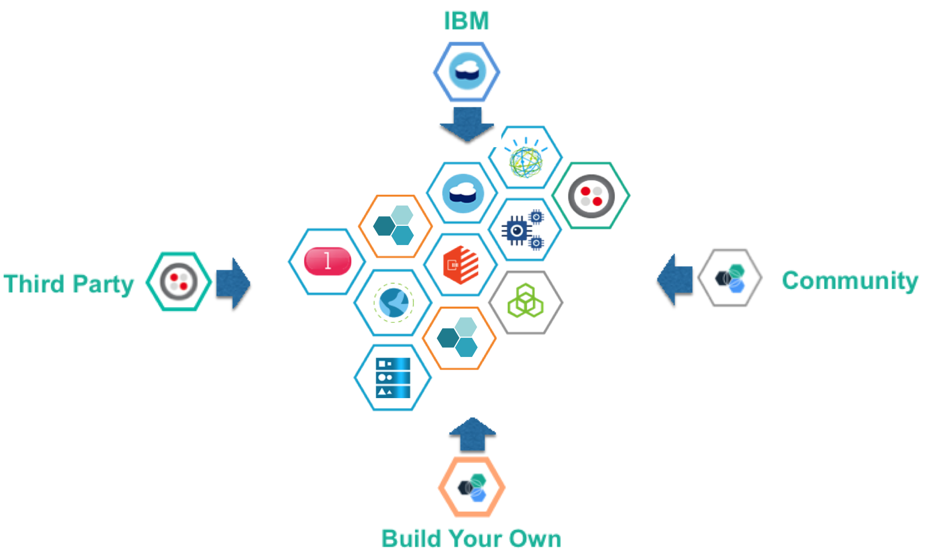
IBM Bluemix – Open Ecosystem for Innovation
Choice
Compute
Runtime
Deployment
Composable 140+ API‘s and services:
Watson, IoT, Analytics, DevOps, etc.
Game Changing
Faster Time to Value: Decreased delivery times from 6 months to 2 weeks
Integrated Insights; A travel company increased bookings by 146%
Customer Loyalty: An airline increased on time departure with new flight crew app
Extensible
OpenSource
Custom API‘s
Monetize API‘s
IBM Confidential | Page 18

Slide 19
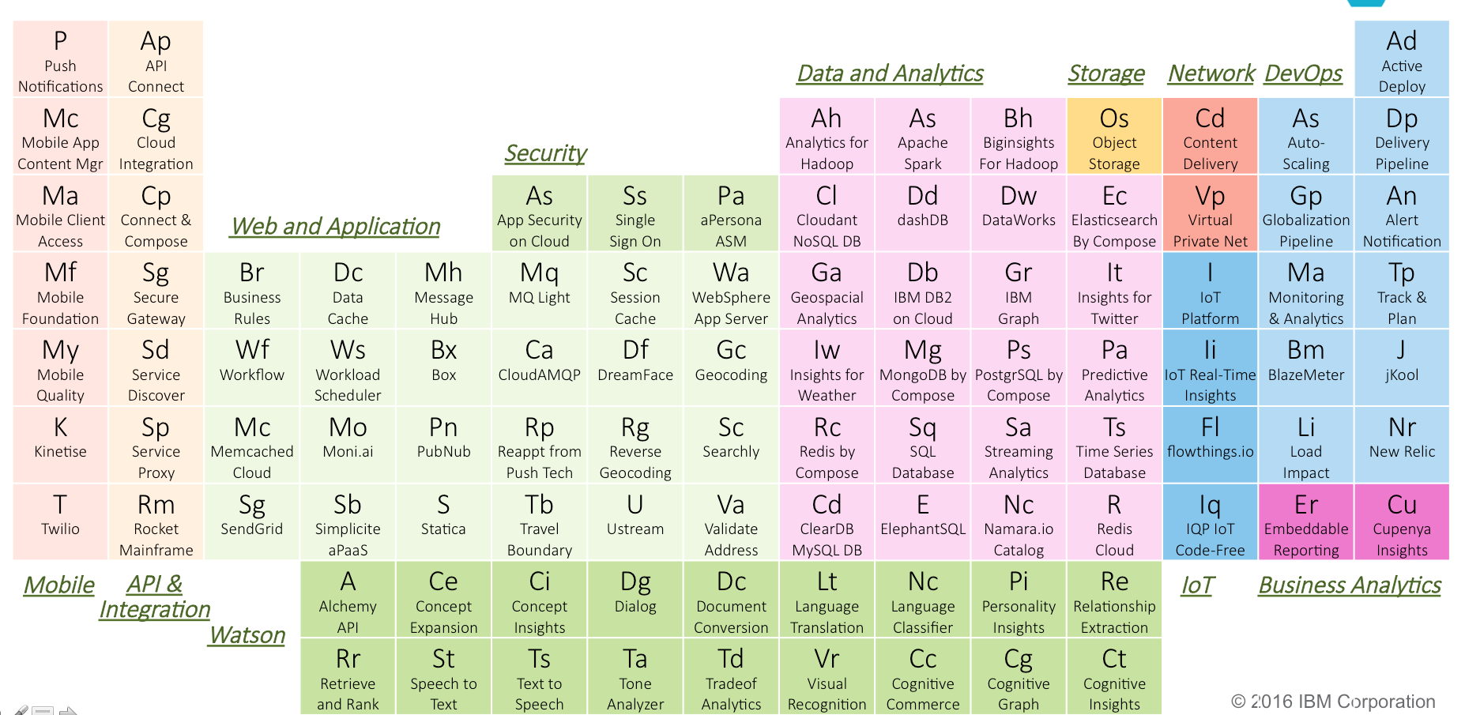
IBM Bluemix +140 Services
IBM Confidential | Page 19

Slide 20
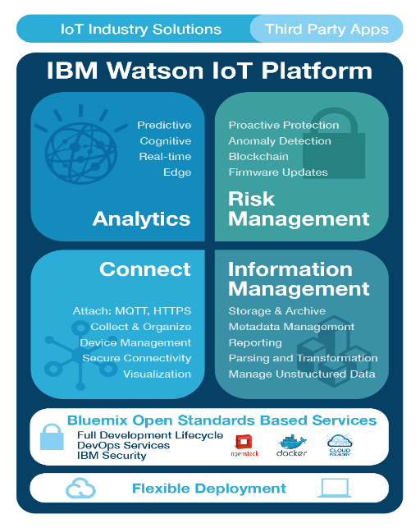
The IBM Watson IoT Platform Everything you need to Innovate with IoT
IBM Watson IoT Platform - Connect
Connect and manage devices, networks, and gateways
IBM Watson IoT Platform - Information Management
Integrating information, structured and unstructured, from devices, people, and the world around us
IBM Watson IoT Platform - Analytics
Gaining insights from information using Realtime, Predictive and Cognitive analytics
IBM Watson IoT Platform - Risk Management
Ensuring you leverage the right information from the right sources, and the right software runs where you need it
IBM Confidential | Page 20

Slide 21




Watson IOT’s cognitive approach overcomes many limitations of traditional computing methods
Natural Language Processing Enables interaction through natural human language and dialog Example: A technician asks about symptoms an asset is displaying. The system uses additional context including location and asset data to understand the intent of the query and returns suggestions for possible causes and repairs. | Machine Learning Automates data processing and continuously monitors new data to learn and improve results Example: The system monitors incoming data from a fleet of equipment to learn both normal and abnormal conditions, taking into account environment and production processes which are often unique to each piece of equipment and location.
Text Analytics Enables mining of textual sources to find correlations and patterns in these vast amounts of untapped data Example: An asset analyst uncovers emerging problems and identifies possible root causes by analyzing the unstructured text found in customer problem reports and maintenance logs. | Video/Image Analytics Enables monitoring of unstructured data from video feeds and image snapshots to identify scenes and patterns Example: Production environments are monitored with video cameras and sensors, and a worker entering a hazardous area without the proper safety equipment is automatically notified and a safety incident is logged.
IBM Confidential | Page 21

Slide 22
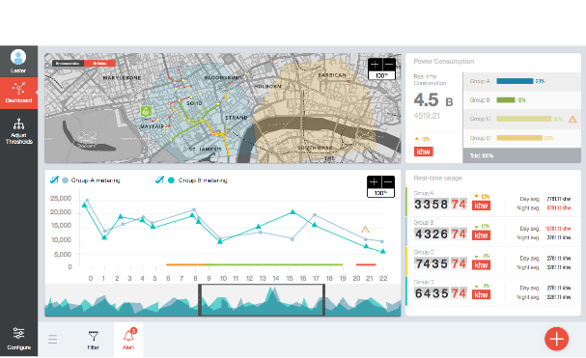






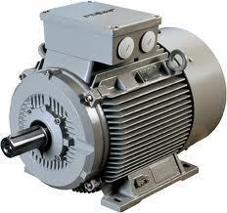

Watson IoT Platform Analytics Real-Time Insights
Contextualizes device data
Monitors streaming data to detect situations
Acts on insights from the data
Real-time dashboard
Real-time data
4
Rules trigger an action, such as
an alert, email, text message or
a work order in Maximo
IoT
Connect
IoT
Analytics
2
Data comes in through
IoT Foundation Connect
3
2
Data drives real-time
analytics and business rules
Data may be collected by a gateway device for connectivity or protocol translation
5
Recommendations drive response in Maximo
3a
1
Data is enriched with external data such as Weather or asset master data
1
1
ASSET
WORK
Management
PROCUREMENT
Sensors provide
information about the device
SERVICE
Maximo
CONTRACT
MATERIALS
Management
SCADA, historians
Real-Time
Device
IBM Confidential | Page 22

Slide 23
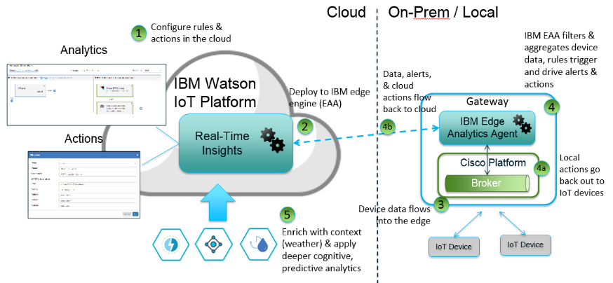
Cutting-Edge Front - Edge Analytics for IoT
Define and manage your cloud and edge analytics in one place
Analyze data close to source
Reduce cost of sending data to cloud
Act on data close to the source
Augment analytic results on the edge with additional analytics on the cloud
IBM Confidential | Page 23

Slide 24
Agenda
Context
Drivers, approach, assessment parameters for ‘ML at Scale’ platform
Autonomic assets: A new lens to view the objectives of ‘ML at Scale’
Conceptual architecture with accelerators and enablers
Architecture
Smarter Resource & Operations Management (SROM)
IBM Predictive Insights & PMQ
Break
Use case discussion
Next steps discussion
IBM Confidential | Page 24

Slide 25

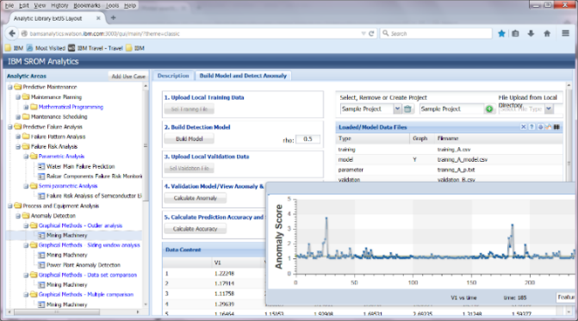
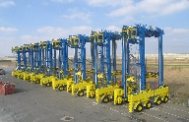




Big Data & Machine Learning with SROM
Data
Analytics Solution for Manufacturing
State-of-the-art algorithms
- Ontology guided, cloud-based Services
- Purpose built (for Mfg) reusable RestAPIs
- Smarter Resource & Operations Mngt (SROM)
Asset/Equipment Attributes
Mixed Integer Programming
Maintenance Planning
Nonlinear Programming
Failure/Repair
History
Maintenance Scheduling
Dynamic Programming
Operations Data
Failure Risk Analysis of Assets
Random Forest
Process Data
Support Vector Machine
Product Attributes
Failure Pattern Analysis of Assets
Neural Network
Environmental Data (e.g., weather)
Anomaly Detection
Client Success Stories
Parametric Analysis
Sensors / Devices
METALS
Machine-learning algorithm build prediction models to anticipate excursions in pot behavior, and improve current and energy efficiency.
Product Quality & Geneology
Semi-Parametric Analysis
Meters
Process Optimization
Graphical Methods
EPC
Predictive project health based on structured and unstructured data analytics
Grid Energy Price (TOD)
Cohort Analysis
Ensemble modeling of multiple machine learning techniques for predictive energy consumption and Identify optimal operation condition of cement grinding process
Resources
Model Predictive Control
CEMENT
Support Vector Machine
Costs / Budget
Predictive Project Health
Predictive modeling for manufacturing process improvement
Hidden Markov Model
DISCRETE MFG
…
Predictive modeling of asset health for oil & gas field components – compressors, ESPs etc
….
OIL & GAS
Multi-modal data fusion
Automatic Feature/Model Selection
IOT PLATFORMS
Automate Sensor Data Ingestion into Semantic Models
Deep Learning for Mfg
COGNITIVE PLATFORMS
Big data enablement
Cognitive Multi-modal Interfaces
IBM Confidential | Page 25

Slide 26





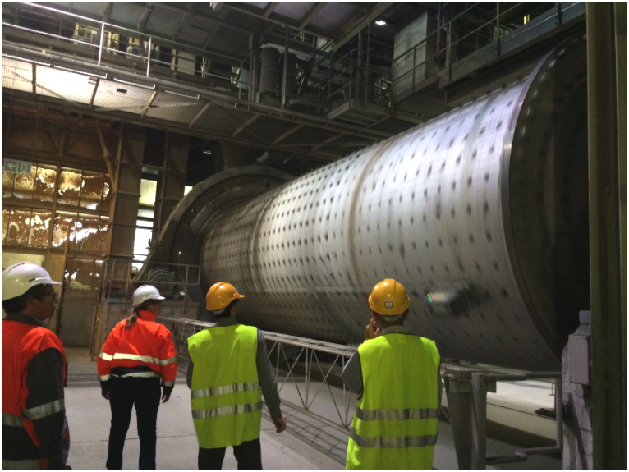
The Value of SROM
Delivers Faster
Adapts Quickly
Keeps Improving
Large oilfield services company wanted to detect anomalous events in its oil wells. They also wanted to test the big data handling capability and ability to use open source technology stack.
IBM tackles over 200GB of data from 197 wells using SROM. IBM research enabled pipeline to reduce data processing time.
Multinational oil and gas company is dealing with its current compressor monitoring system which was failing to predict more than 30% of outages
SROM leveraged current library to create a custom algorithm that would improve ability to generate rules for anomaly detection and dynamically capture changing system states.
Global building materials company wants to more efficiently operate its mill grinding process whose electricity consumption adds up to be 25% of the plant’s total cost.
Cognitive Mill Advisor System is added to the asset library by leveraging a set of available algorithms developed by IBM Research.
Benefits of using SROM:
Efficient Big Data ingestion pipeline and available anomaly detection algorithm helped reduce PoC enablement from 12-weeks to 3-weeks. Average accuracy of 100% (synthetic data set) across models.
Benefits of using SROM:
Successfully demonstrated the capability of quantitatively characterizing symptoms of failure events not detectable by current solution without using any domain knowledge.
Benefits of using SROM:
Stochastic optimization approach found the set of optimal set points of the control variable that minimize energy consumption by 2-4% while maintaining product quality.
IBM Confidential | Page 26

Slide 27
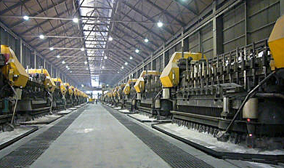
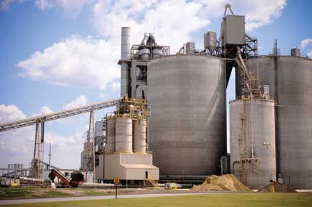




Solving real problems: Examples of recent client projects
Predict anomalies in Aluminum smelter pots that cause energy efficiency degradations
Being used to identify optimal operation condition of cement grinding process
Provide early headlights on project health for large engineering construction projects
Successfully identified an indication of a critical failure in apron feeders of their mining equipment
Improve throughput in semiconductor fabs using virtual metrology
Provided an anomaly detection system for vessel engines
IBM Confidential | Page 27

Slide 28
SROM Analytics Pipeline
Data visualization tools
Data ingestion from file system, RDBMS, HDFS, NoSQL databases
Model results visualization tools
Framework for model & feature selection
Configuration of error types
Validation results visualization tools
Configuration of prediction results
Prediction results visualization tools
Data Curation & Visualization
- data schemas
- data mapping tools
- D3 visualization widgets
Upload Training & Test data
Build Model
Validate Model
Predictions
Model selection & binding
Provide predictions
Data ingestion
Precision and recall trade-off
Mapping customer data to SROM templates
Big Data handling
Automated model selection
Feature selection
Feature extraction
ROC curves
Class imbalance handling
Error measures
Anomaly scores
Real-time analytics for monitoring
Root cause analysis for diagnostics
Task Pipeline
- Workflow orchestration
- RESTAPI enablement
- Big data handling
- Bluemix services
- Front-end design
(angular JS or Perez)
Domain Ontology
Semantic Models
Feature extraction libraries
State of the art algorithms – from R, Scikit Learn, Spark ML
Novel algorithms from IBM Research
Cross-validation framework
Time Window based validation for time series
Methods for various errors
Real-time enablement of predictions
Cognitive Analytics
- Semantic models
- ML libraries
- Automation
- class imbalance
IBM Confidential | Page 28

Slide 29
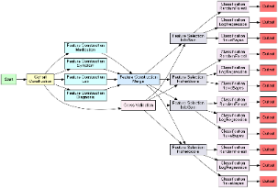
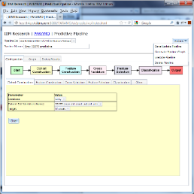
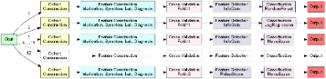

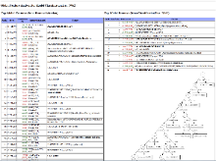

SROM Use Cases and Capabilities
Use Cases
Data Scientist
Use UI and visualizations to configure, build, and evaluate different models with different configurations and scripts to generate reports
Research Developer
Extend system by developing new analytic pipelines, new components, and new component algorithms.
Integration Developer
Use REST APIs to build new UIs, new applications, or integrate functionality into third party applications.
Plug-in Analytics Architecture
Standardized Modeling Pipeline
Dependency Graph Generation
REST APIs
Management UI
Capabilities
Custom Analytic Pipelines
Pipeline Configuration
Automatic Model & Feature Selection
Reports
Custom Analytic Components
Dependency Graph Execution
Parallel Computing Infrastructure
IBM Confidential | Page 29

Slide 30
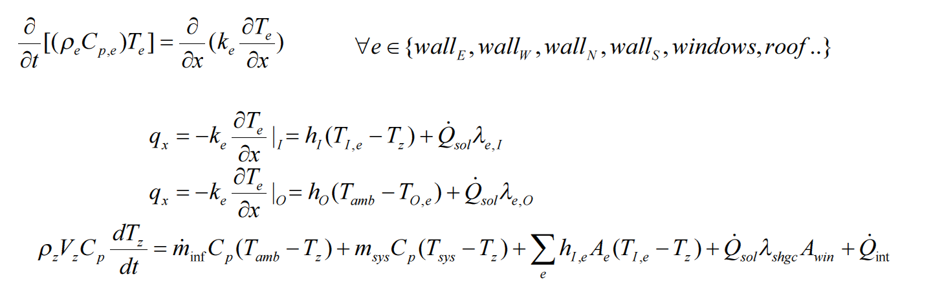
IBM recommends an IOT, machine learning approach to modeling building energy consumption
IOT, cognitive computing (ML) enables near real-time,
energy efficient control of HVAC operation
Physics Model (Reduced Order)
ML model is easier to calibrate for each building, adaptable to
change (degradation) of building performance
Machine Learning Model (Data Driven)
e.g., NARNET (Non-Linear Autoregressive with External Input) Neural Network
IBM Confidential | Page 30

Slide 31
IBM recommends ML-based Model Predictive Control of HVAC for demand response with ESS and EGS
Simultaneously optimize (1) HVAC operation (e.g., set point profile of the HVAC system) and
(2) Supply for the power (load) needed by the HVAC system through grid purchased energy, on-site stored energy (battery, EV..), on-site generated energy (co-gen, PV..) and other sources (geo-thermal…)
total energy supply
total load for HVAC system
Data
Weather Forecast
Occupancy
Zone temperature
Power meter
Set point
….
Data
Energy Cost
….
Grid Electricity
Purchased
Grid Electricity
For HVAC
Energy Supplied
To HVAC
Energy Required
by HVAC
ML
Model
ESS charge
efficiency
ESS Stored
Electricity
ESS
discharge
efficiency
EV
Control variables (t)
Self discharge
Co-Gen
CHP
efficiency
CHP
From Co-Gen
Natural Gas
Used
Objective Function:
Optimization Model (MINLP, MILP)
PV
Subject to:
(Sourcing Constraint for HVAC Power)
(ML Based Thermal Behavior Model)
Other constraints (physical limitation of HVAC system, ESS, EGS etc.)
IBM Confidential | Page 31

Slide 32
How IBM delivered a cost reduction of over 23%: Example optimal solution from MPC for HVAC System PC based on IOT + ML
Significant energy cost reduction: 6.36% for HVAC operation only, and 23.06% for HVAC operation + optimized scheduling ESS and ESS with respect to a typical control method, for a midsized commercial building (East Coast, U.S.)
Optimization
of energy demand
(operation)
Grid Electricity Price
Optimization
energy storage
Optimization
of energy supply
 | *Night Setup Control (base) | **Optimal Solution (without ESS and EGS) | Optimal Solution (with ESS and EGS)
Cost | $98.11 | $91.88 | $75.49
Saving (w.r.t. base) |  | 6.36% | 23.06%
* No consideration of ESS and EGS
** With ESS and EGS included in optimization, but assumes all energy is sourced from grid electricity
IBM Confidential | Page 32

Slide 33



Example of Mining Equipment Health: Anomaly detection for early event identification
training
Compute dependency graph in the training region
Do the same for the test region
Compare in an information-theoretical fashion and provide change score
→ provide alerts
Fully automated and no manual feature engineering required
MACH
I
NE
LEARN
I
NG
test
Cognitive Asset Health Advisor
IBM Confidential | Page 33

Slide 34
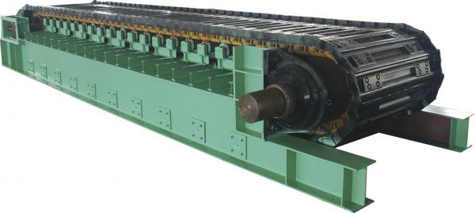
Anomaly Detection for Mining Equipment (Apron Feeder)
Sensor variables (left and right)
Gear box temperature
Motor current
Motor power consumption
Motor rpm (need double check)
Apron speed (need double check)
L
R
IBM Confidential | Page 34

Slide 35
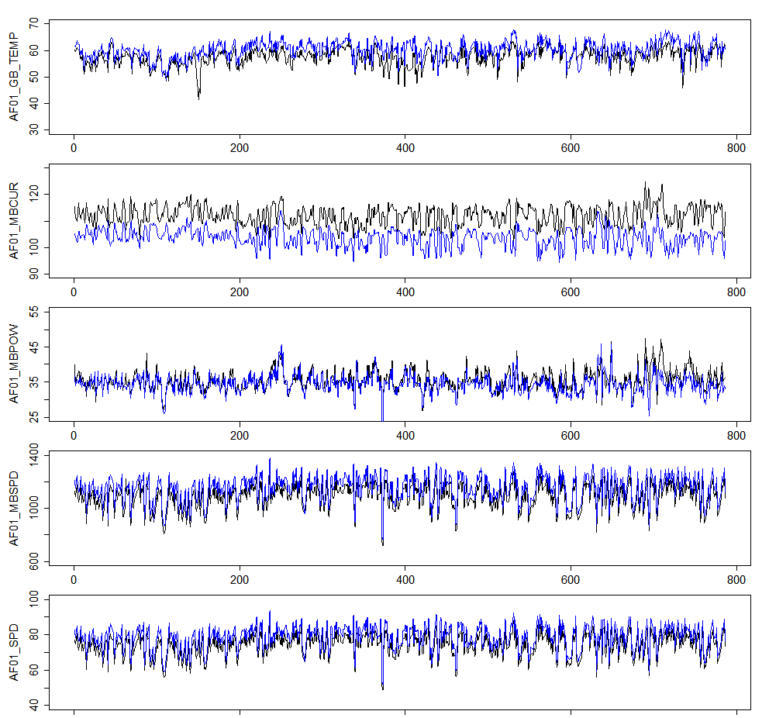
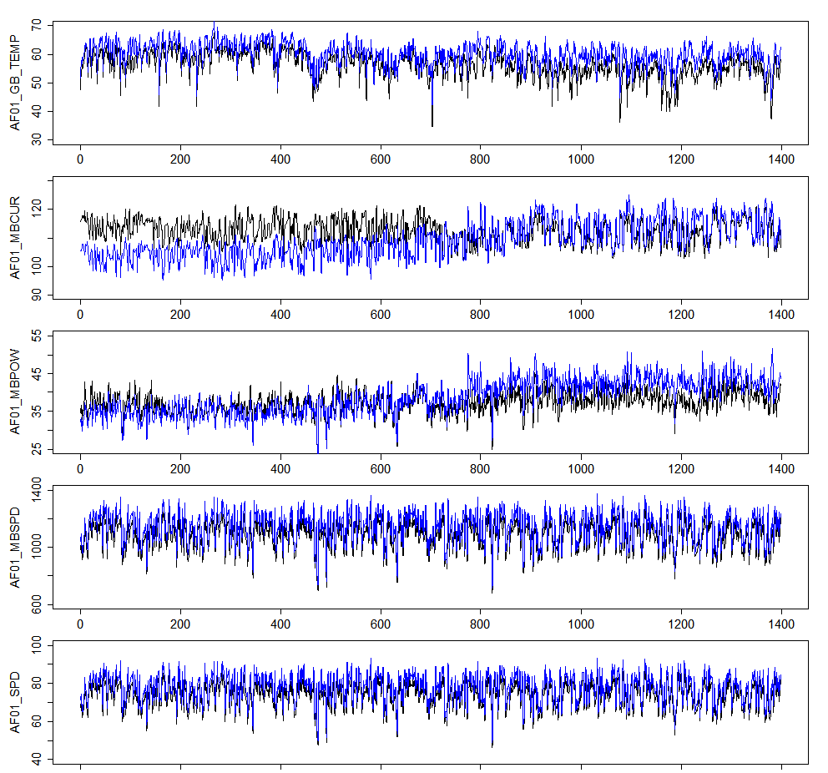
Observing long-term trends: Comparison between normal and pre-failure periods (black=AF1, blue=AF2)
Normal operation (Jan-Aug 2014)
Pre-failure period (Jan 2015-Aug 2015)
2014/08/01 00:00 - 2014/12/31 23:59
2015/01/10 14:38 - 2015/08/10 15:38
IBM Confidential | Page 35

Slide 36
Result: successfully captured the change
Change-point score
Computed change-point score for the pre-failure period
w = 120 time points (5 days)
The change in the trend is clearly captured by the algorithm
Sudden rise of CP score at about 800
After the first major transition, another minor changes seem to have happened
Pre-failure period (Jan 2015-Aug 2015)
IBM Confidential | Page 36

Slide 37
Agenda
Context
Drivers, approach, assessment parameters for ‘ML at Scale’ platform
Autonomic assets: A new lens to view the objectives of ‘ML at Scale’
Conceptual architecture with accelerators and enablers
Architecture
Smarter Resource & Operations Management (SROM)
IBM Predictive Insights & PMQ
Break
Use case discussion
Next steps discussion
IBM Confidential | Page 37

Slide 38
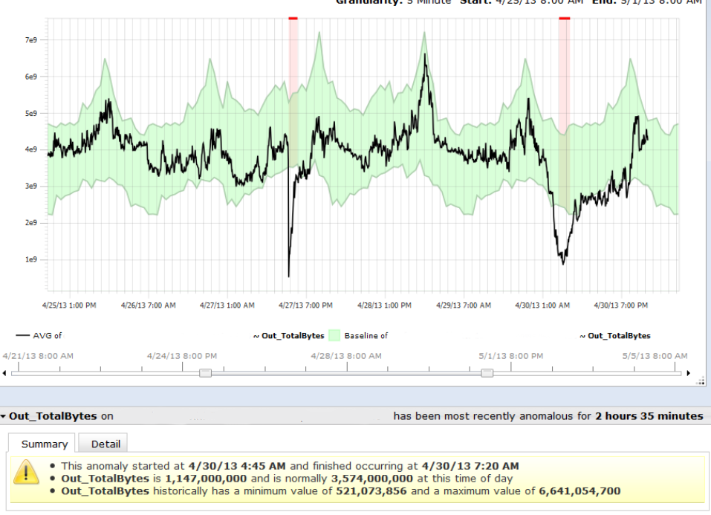
IBM Predictive Insights: ‘ML in a box’ approach helps prevent outages by dynamically tracking metrics to identify normal vs. abnormal behaviors
Predicative Insights learns the normal historical range
It will trigger an alarm if it falls outside this range
IBM Confidential | Page 38
Notes:
38

Slide 39
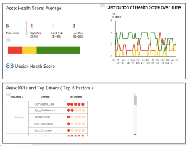
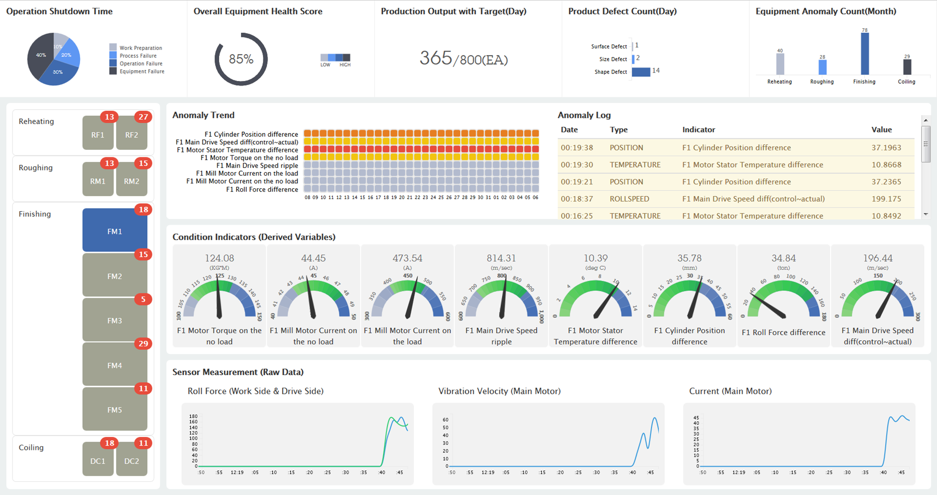
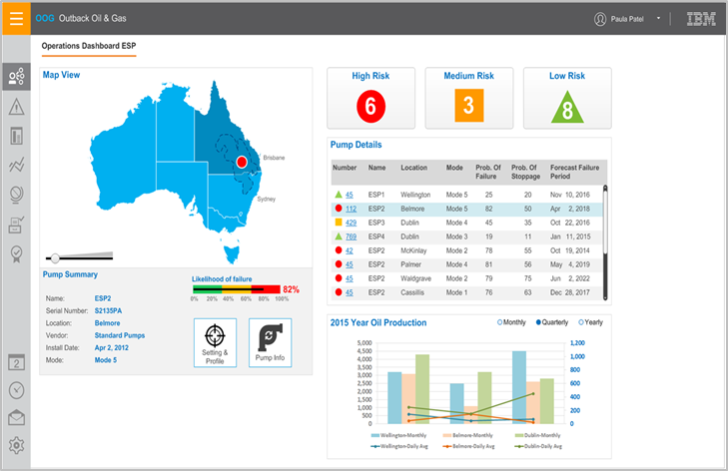


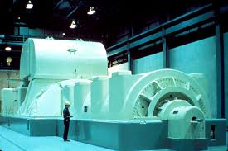



IBM Predictive Maintenance and Quality value propositions
Faster “Time to Value” with Pre-built Analytics
Quality Early Warning System
Advanced quality analytics for early detection of process variation and field failures (warranty)
Proven successful in automotive to detect warranty issues 1-2 years sooner than traditional analytics
In depth statistical analytics and data mining for root cause failure analysis
Maintenance and Sensor Asset Analytics
Advanced Modeling / Custom Analytics compatible with other analytics software
Real-time intelligent prediction of machinery health
Integrates with custom analytics, text analytics for enhanced asset health prediction
Pre-built Reporting
Top Failure Reporting - analyze and discover top percentile or number of parameters that can predict defects
Maintenance Dashboards
Statistical Process Control Reports
Event Orchestration
Orchestration ties activities in Predictive Maintenance and Quality together through IBM Integration Bus message flows
Master Data Management
Operator-oriented pre-configured master data entry, modification
Asset hierarchy management
Successfully deployed
Industries
Aerospace, automotive, chemical & petroleum, communications, electronics, industrial products, energy & utility, manufacturing, mining, transportation
Example benefits
97% ability to predict delays within 12 weeks
87% accuracy within 48-hours about potential failures
45.5% reduction in unplanned maintenance
25% increase in overall production line productivity
30% greater efficiency in chiller performance
50% anticipated reduction in service costs
IBM Confidential | Page 39

Slide 40
Agenda
Context
Drivers, approach, assessment parameters for ‘ML at Scale’ platform
Autonomic assets: A new lens to view the objectives of ‘ML at Scale’
Conceptual architecture with accelerators and enablers
Architecture
Smarter Resource & Operations Management (SROM)
IBM Predictive Insights & PMQ
Break
Use case discussion
Next steps discussion
IBM Confidential | Page 40

Slide 41
Agenda
Context
Drivers, approach, assessment parameters for ‘ML at Scale’ platform
Autonomic assets: A new lens to view the objectives of ‘ML at Scale’
Conceptual architecture with accelerators and enablers
Architecture
Smarter Resource & Operations Management (SROM)
IBM Predictive Insights & PMQ
Break
Use case discussion
Next steps discussion
IBM Confidential | Page 41

Slide 42
Sample Scoring Matrix
Priority Metric | Measure | Value (0-5)
Business Value | Quantifiable | 5
 | Measurable | 5
 | Strategic | 5
 | Sub Total | 15
Operational Readiness | Use Case Defined | 4
 | Business Process Alignment | 5
 | Informational Readiness | 4
 | Sub Total | 14
Strategic Alignment | Time to Value (60-120 Day Increments) | 3
 | Leverage Investments | 2
 | Executive Sponsorship (TBD) | 4
 | Sub Total | 9
 | Total | 38
IBM Confidential | Page 42

Slide 43
List of applicable use cases
Use Case | Use Case Hypothesis | Business Value Highest value=5 | Complexity Ease to implement=5
1
2
3
4
5
6
7
8
9
10
IBM Confidential | Page 43

Slide 44
The end
IBM Confidential | Page 44

Slide 45
Back-up slides
IBM Confidential | Page 45

Slide 46

Watson IoT is ready to work with you to change the world
USD 3 billion:
4,000:
First:
IBM’s four-year investment in cognitive IoT
IoT clients, including leaders in a diverse set of global industries
The industry's first dedicated cognitive business consulting practice⁶
750:
20:
IoT patents, three times more than any other company⁵
industries that are benefiting from Watson technology today, in 25 countries
15 billion:
10,000:
security events managed daily
security clients in 133 countries
IBM Confidential | Page 46
Notes:
IBM technologies are driving innovation and safeguarding organizations worldwide, with more than 750 IoT-related patents—three times more than any other company. We have more than 24 Watson APIs, including four specifically designed to advance cognitive IoT, powered by 50 different cognitive technologies. Ours is the industry’s first consulting practice dedicated to cognitive business, drawing on 2,000 experts on industry dynamics, data science and analytics. There are Watson clients in 25 countries and 20 industries. More than 250 global professionals offer services in IoT integration, analytics, big data, platform architecture and strategy consulting.
We’re also managing the security concerns associated with IoT. We have 10,000 security clients in 133 countries and manage 15 billion events a day.
We’re committed to growing our cognitive IoT business. We’re investing USD 3 billion into cognitive IoT over the next four years.

Slide 47
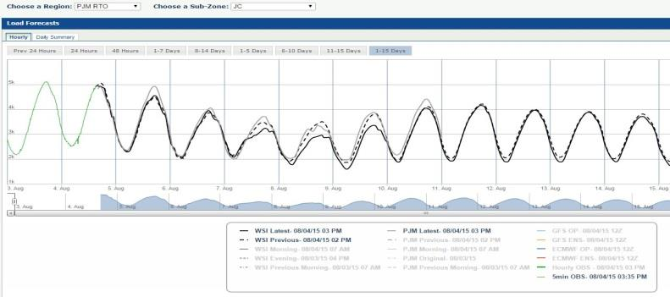
TWC provides proven load forecasting models using high accuracy high precision weather forecasts
Proprietary Load Forecast model uses Forecast on Demand as primary engine
Specific modeling for time of day, day of week, seasonal, holidays and related calendar effects
Uses autoregressive modeling to provide best load forecasts
Forecasts update every 15 minutes with latest observations for critical short term updates
Example of our 15-Day PJM Load forecast
Issued August 4, 2015
IBM Confidential | Page 47
Notes:
http://en.allmetsat.com/metar-taf/

Slide 48
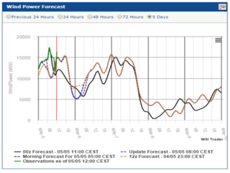
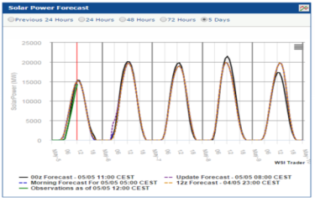
Intelligent energy sourcing: TWC offers a rapidly expanding set of renewable energy forecasts
Wind Power Forecast
Solar Power Forecast
Forecast renewable wind & solar energy in lucrative European markets
Hour by hour forecast updating every 15 minutes
Granular forecasts TSO zones (3 separate zones in Germany)
Offered since 2014 including Germany and UK
10 New European countries to be released this year
US Renewable forecasts on the roadmap
IBM Confidential | Page 48

Slide 49
TWC rapid refresh weather forecasts feed accurate short term load predictions
15-minute updates with observations and latest models promotes significant error reduction within 0-6 hour forecast
Statistical forecast verification on high-density personal weather stations improves 6-24 hour forecast
Use of multiple global forecast members provide improved forecasts out 15 Days
Average Load – 31.8 GW
Peak Load – 61.7 GW
TWC
PJM
Lower values = Less error
PJM Grid vs TWC Load Forecast
MAPE (Mean Absolute Percentage Error)
for 2012 to 2014
IBM Confidential | Page 49

Slide 50
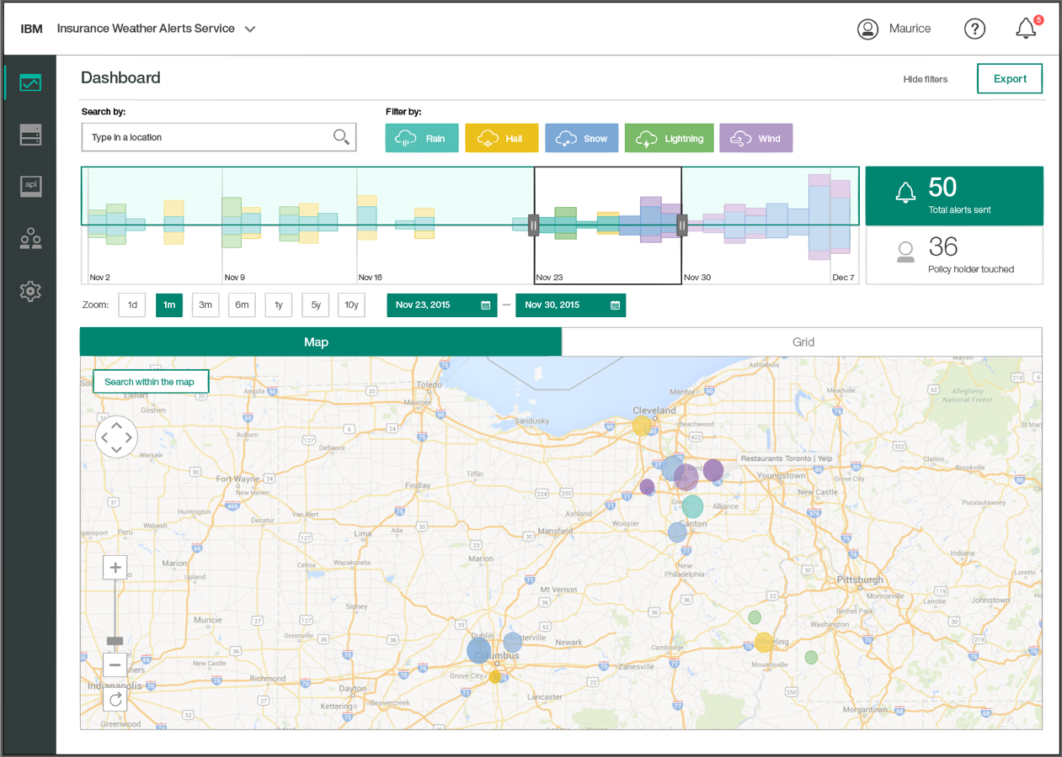
IBM Weather Alerts provide better incident reporting for critical weather thresholds, assisting in predictive and proactive maintenance
Powered by the best data
The Weather Company’s premium, high-precision data
Precision down to 500 meters
2.2 billion global forecast locations generating 15 - 26 billion daily forecasts
Updates on 15 minute intervals
Other weather data is low precision, covers broad areas, and is updated infrequently which could backfire with false positives that tarnish client relationships
Use Cases
Proactive employee safety actions
Predictive maintenance / safety inspections and dispatch optimization
Supply chain optimization of parts / product post event
Interactive dashboard showing static asset alerts across timelines and locations
IBM Confidential | Page 50
Notes:
IBM® Demand Insight for Retail helps improve in-stock service levels while maximizing inventory turns, efficiency and overall profitability. IBM created a demand analytics solution for a global retailer harnessing the power of predictive analytics and cognitive computing. Align staffing levels, schedules and labor budgets to needed workloads based on forecasted sales, store traffic and inventory receipts. Achieve marketing objectives efficiently and effectively through timely and relevant marketing programs / promotions deployed across multiple channels.
Name
Tagline
Visual of Solution
Data Sources/Types
Solution Capabilities
Generates this ….
Predict this …
Identifies that …
Business Benefits
Improves this …
Reduces that …
Generates this …
ADD: Key Differentiator?

Slide 51




Enabling ML at scale for complex fault, optimization problems: Conceptual / functional solution map (See notes)
IoT Gateway
Functional solution map
Visualization,
Data Mining
& Exploration
Channels
Services Catalog
Access: • Metering • Collaboration • APIs • Sandbox
Data Scientists
IoT
Devices/Sensors
Edge analytics
Information Interaction Zone
Analytical or
Predictive
Models
AaaS (Analytics as a Service)
Visualization, BI,
Collaborative storytelling
…
OSS/BSS
…
Data Stores
Applications (Call Center/SOC)
3Party
Real time sources
DaaS (Data as a Service)
IoT Services
Data Users
User Reports & Dashboards
Data Science Zone
Preprocessors, Codified Features and Models
Workflow
Machine
Learning
Cognitive
Services
Stream analytics
IoT analytics
Optimization
Device
Management
Systems
Data Management Zone
External Vendors and Customers
Service operation applications
Operational Store
Analytical Stores
Call Center applications
Ingestion and blending (Batch, Streaming, IoT)
Data Lake
Platforms: Security • Big Data • Streaming • IoT • ML Tools • DevOps • Others
IBM Confidential | Page 51
Notes:
Map to the sub topics : Call out which one is:
SROM
Op Analytics
IoT/Watson Arena
Cloud vs. Premise
Problem we are solving
Same architecture – future solution vision

Slide 52
IBM offers set of enablers and accelerators to enrich as well as scale up Analytics, Optimization and IoT Services
Information
Interaction
Zone
APIs
UI/Reports
Maximo Workflow
Sandbox
Operational Analytics
Log Analytics
Predictive Insights
Watson IoT Analytics
Real-time insights and action & Video/Image Analytics
Watson Cognitive Service
T2S
Sentiment analysis
NLP
Pipelines (SROM)
Anomaly Detection
PMQ
Asset quality analytics
Maintenance optimization
..
Edge Analytics
Contextualize IoT data w/external asset data
Data
Science
Zone
Data
Management
Zone
AAF
Adapters & Enrichment
Industry Data Models
Data sourcing(Weather,..)
Platform:
Data
Data Stage
IBM Streams
Apache Spark
Store
DB2
Apache Hadoop
Analytics
Cloudant NoSQL
IBM Graph
..
SPSS
Spark ML
Customize Algorithms
Data Works
MDM
Cognos
BigInsights
Other..
IBM Confidential | Page 52

Slide 53










The PMQ stack
All Data
New/
Enhanced Applications
Big Data & Analytics Strategy, Integration & Managed Services
Big Data & Analytics Platform
Data Stage
MDM, Optim, Guardium, IIG, BigMatch
What is happening?
Watson Analytics, Watson Explorer
InfoSphere Streams
DB2 Blu
DB2 Blu, Information Server
PDA, Industry Data Models
What action should I take?
CPlex, ADM
What did I learn, what’s best?
Cognitive
Why did it happen?
Cognos BI
BigInsights
What could happen?
SPSS Modeler, SPSS Stats
Tivoli/Maas360, System x/Power, MobileFirst/BlueMix, WebSphere, ECM/box and Softlayer
IBM Confidential | Page 53

Slide 54

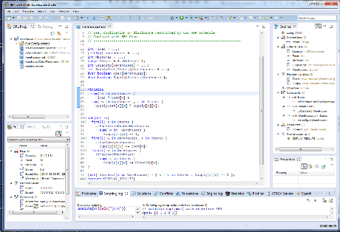
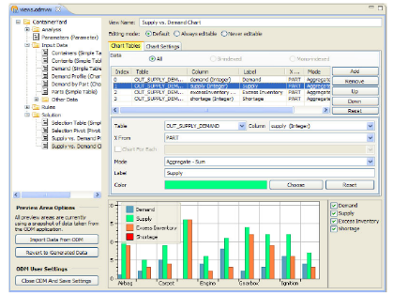
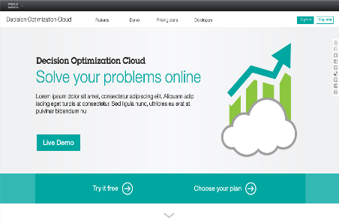
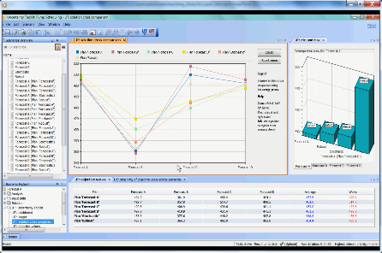
IBM Optimization Technology
Decision Optimization Center (DOC) Development & Deployment Platform
CPLEX Optimization Studio (COS)
Dev Platform & Optimization Engine
Platform for building optimization solutions. Provides Data analysis & Visualization,
Scenario management & Editing, Collaborative planning, and What-if / Sensitivity analysis
Model business issues mathematically and solve them with IBM CPLEX Optimizer's powerful algorithms to produce precise and logical decisions.
DOCloud Optimization as a Service
Stochastic Optimization
Advanced Tools & Assets
Delivers a powerful SaaS based experience for prescriptive analytics that allows our users to try, buy, and deploy an optimization service that is tailored to their business needs.
Reduce reliance on PhD-level expertise. Improve understanding of trade-offs (e.g. cost vs robustness)and increase model /solution stability & value.
IBM Confidential | Page 54

Slide 55
What is changing? Big Data Enhanced Analytical Capabilities New sources, real-time analytics, deeper regulation, new technology
New
Sources
Information
Interaction
Sensors
producing
readings
Information Access
Interactive Analytics,
Exploration and Discovery
Information
Ingestion
Analytics Sources
Internet
Shared Analytics Information Zone
Planning, Optimization, Alerting and Reporting
Visualization,
Data Mining
& Exploration
Data Scientists
Social Media
Services
Map Reduce &
Deep Data Zone
Integrated Warehouse
& Marts Zone
Landing
Area Zone
Visualization, Collaboration and
Storytelling
Analytical or
Predictive
Models
Customer
Conversations
Information Virtualization Layer
Streams, Transformation
Engines
Exploration
Zone
Unstructured Public and
Internal Sources
Real-time Decision Management
Subject Data Users
User Reports & Dashboards
Systems of Engagement
Back office
Applications
User Guided & Advanced Analytics
Shared Operational Information Zone
Master & Reference Data Hubs
Content
Hub
Activity
Hub
Insight Hub
Metadata Catalog
Accelerators and Development Frameworks
Event Detection and Action
Monitoring
Governance, Risk and Compliance
Information Governance
Corporate Governance
Security and Business Continuity Management
Encryption
Access Control
IBM Confidential | Page 55

Slide 56
Overall Data Flows from all sources
Experimental Sources
Data Sandbox Areas
Data Exploration
Visualization,
Data Mining
& Exploration
Data Scientists
Self Provisioning Data
Analytical or
Predictive
Models
Data Prediction
Subject Data Users
New Sources
User Reports & Dashboards
User Guided & Advanced Analytics
Detailed System of Record Data
Data Delta
Detailed System of Record Data
Detailed Data Aggregates
Summary
Data Aggregates
Dimensional
Data
Legend
Landing Area
Hadoop Data store
RDBMS Data Store
Hybrid Data Store
Legacy
Sources
Raw Data
Detailed somewhat Modelled Data
Detailed Modelled Data
New Sources may be supplemented with data from Legacy sources as well as with data from Experimental Sources
Aggregate Data
Calculated Data
IBM Confidential | Page 56

Slide 57

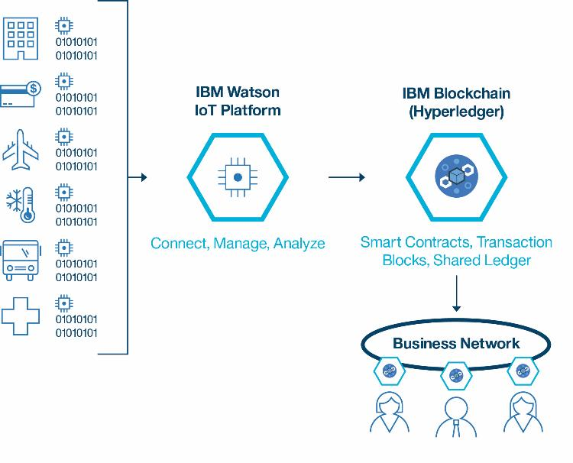
Cutting-Edge Front - Blockchain and Watson IoT
The IBM Watson IoT Platform enables IoT devices to send data to private blockchain ledgers for inclusion in shared transactions with tamper-resistant records.
Blockchain’s distributed replication allows business partners to access and supply IoT data without the need for central control and management.
IBM Confidential | Page 57
Notes:
Announcement website: http://www.ibm.com/internet-of-things/iot-news/announcements/private-blockchain/
IBM Blockchain provides a private blockchain infrastructure of distributed peers that replicates the device data and validates the transaction through secure contracts.
Watson IoT Platform translates existing device data, from one or more device types, into the format needed by the blockchain contract APIs. The blockchain contract doesn’t need to know the specifics of your device data.
Watson IoT Platform filters device events and sends only the required data to the contract

Slide 58

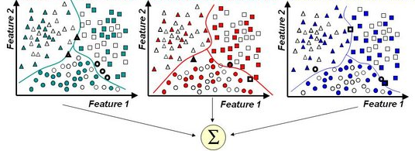
Example: Cement Mill: Optimized mill and cross-mill analysis
Predictive learning
Use plant data to model functional relationship of major variables
Automate model building and learning
Based on the model, we
Perform comparative study between multiple mills
Set points for optimized operation
Advisory Control
(~day to week)
via cognitive technologies
Automate set points for optimized operation
Plant data to build prediction model for operational variables
Mill Master
Optimized mill operation
Low-level control system (~ms)
PCS7
Cognitive Plant Advisor
cross-mill comparative analysis
Automate model building across mills
IBM Confidential | Page 58

